Slide 1
Understanding of Mechanisms of Change in ACT
Ron Rogge
Jenna Macri, Katie Saint, Brooke Dubler, & Jaci Rolffs
University of Rochester
The Chicago School of Professional Psychology

Slide 2
ACT
3rd wave CBT
Relational Frame Theory
180+ studies
  psych distress
  chronic pain
  stress
  smoking
  weight loss

Slide 3
Inattention
Unawareness
Experiential Avoidance
Lack of Contact w/ Values
Inflexibility
Fusion
Inaction
Self-as-Content

Slide 4
Present Moment Awareness
Contact w/ Values
Acceptance
Flexibility
Committed Action
Defusion
Self-as-Context

Slide 5
Targets in ACT
  AAQ-II
  MPFI
Inflexibility
Flexibility

Slide 6
ACT Mechanisms
36 studies
  AAQ-II
  13 for psych distress
  INFLEX ➔ distress / depr / anx
  PM aware ➔ stress / depr / anx

Slide 7
GOAL
Examine specific mechanisms
  6 forms of FLEX
  6 forms of INFLEX
➔ MindFlex Assessment Project

Slide 8
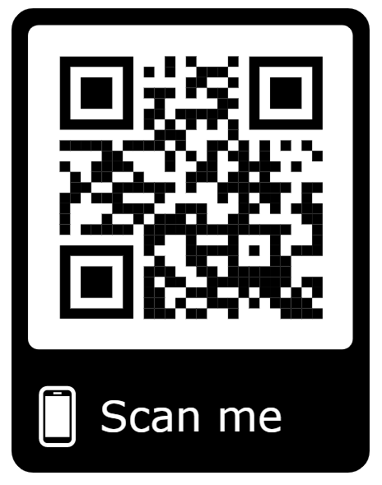
MindFlex Assessments
Online
Free
15-20 min
  FLEX & wellbeing
  scored
  normed
  graphed ➔ profile

Slide 9
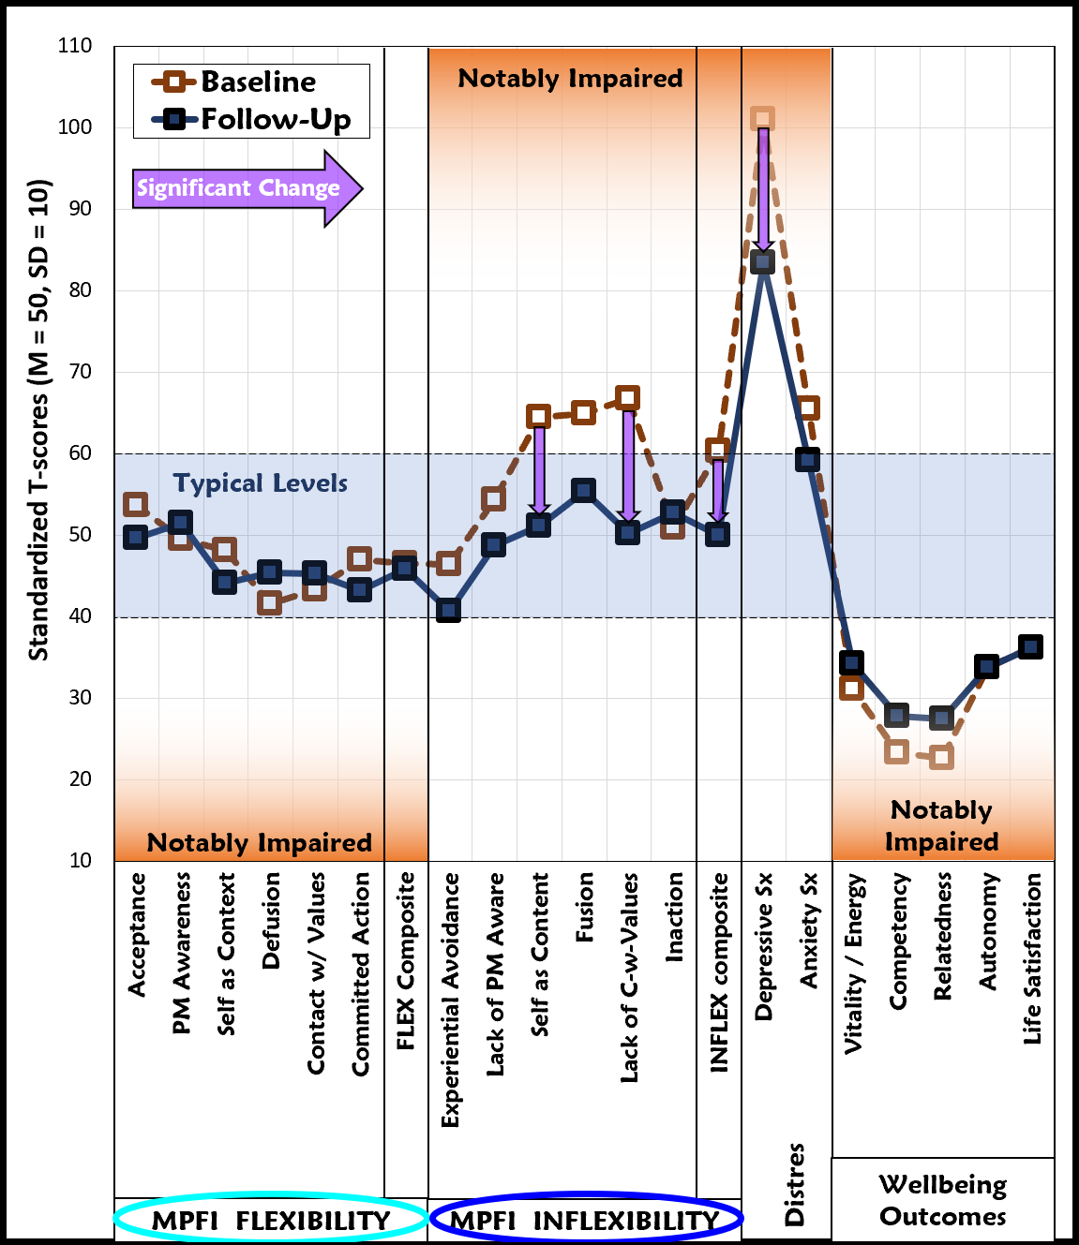
MindFlex
Profiles
T-scores
  Baseline
  Sig. change

Slide 10
MindFlex Assessment Project
Research study
Validating MindFlex
  Clinical samples
  Therapists’ impressions

Slide 11
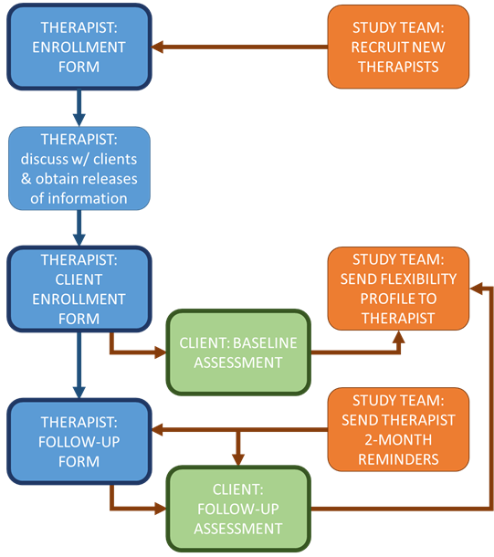
Procedure
Therapists
  ➔ clients
  ➔ profiles

Slide 12
Sample
10 therapists ➔
  ACBS
  50% male
  80% white
  M = 78 hours of ACT training
32 clients
  depr / anx
  47% male
  72% white
  individual tx

Slide 13
Method
Client data
  Baseline assessment
  2-month follow-up
      (n=20)

Slide 14
Measures
FLEX / INFLEX
  MPFI AAQ-II
Distress
  Depr Sx (PHQ-9)
  Anx Sx (GAD-7)
Wellbeing
  Vitality (SVS)
  Life Sat. (SWLS)
  Need Sat. (BPNSFS)
      Relatedness
      Competency
      Autonomy

Slide 15
Analyses
FLEX change ➔ outcome change
Outcomes
  Depr Sx
  Life satisfaction
  Competency
  Relatedness
Controls
  Tx motivation
  Working alliance
  Therapist insens.

Slide 16
Δ Depressive sx
FLEX
  Acceptance
  Defusion
  Self-as-context
INFLEX
  AAQ-II
  Fusion

Slide 17
Δ Life satisfaction
FLEX
  Defusion
INFLEX
  AAQ-II
  Fusion

Slide 18
Δ Competency
FLEX
  Self-as-context
  Defusion
  Contact w/values
  Commited Action
INFLEX
  Inaction

Slide 19
Δ Relatedness
FLEX
  Contact w/values
INFLEX
  Lack of contact w/ present moment

Slide 20

Summary
Mediation
Outcome specific
MPFI / MindFlex
  Tracking change
  ➔ linking dynamics

Slide 21
Limitations
Preliminary
Short interval
Established clients
Disorder specific?

Slide 22

Thank You!
♥

Slide 23
Mediation in ACT for Psych. Distress
First Author | Year | Design | Population | Subjects (# at follow-up) | Treatment | Outcome | Mediator | Mediator Scale | Mediator Results
Fledderus | 2010 | RCT | Clinical | 93 (81) adults mild/mod distress | 8x2hr ACT group vs Waitlist | mental health | Inflexibility | AAQ-II | ACT--> pre-post Δ ↓ Inflexibility--> Δ pre-post ↑ mental health
Muto | 2011 | RCT | Community | 70 (68) international students | 8wk ACT workbook vs Waitlist | psychiatric distress | Inflexibility | AAQ | ACT --> Δ pre-post ↓ Inflexiblity --> Δ pre-4mo ↓ psych distress
Bohlmeijer | 2011 | RCT | Clinical | 93 (77) adults with mild to mod distress | 8wkx2hr ACT group vs Waitlist | depression | Inflexibility | AAQ-II | ACT --> Δ pre-post ↓ Inflexiblity --> Δ pre-5mo ↓ depressive sxs
Morton | 2012 | RCT | Clinical | 34 (10) adults with Borderline Personality Disorder (BPD) symptoms | 12x2hr ACT group & Public Mental Health Services/Med Management (TAU) vs TAU | BPD symptoms & hopelessness | Inflexibility | AAQ-II, DERS & FFMQ totals | ACT --> pre-post Δ ↓ Inflexiblity --> Δ pre-post ↓ BPD sxs ACT --> pre-post Δ ↓ Inflexiblity --> Δ pre-post ↓ hopelessness
Fledderus | 2013 | RCT | Clinical | 376 (250) adults with mild-moderate depr/anx | 9wk. ACT workbook/email support vs Waitlist | depressive & anxious sxs | Inflexibility | AAQ-II | ACT --> pre-post Δ ↓ Inflexiblity --> Δ pre-3mo ↓ depressive & anxious sxs
Juarascio | 2013 | RCT | Clinical | 140 (63) women in residential tx for eating disorder | 2xwk. ACT group & behavioral intervention (TAU) vs TAU | disordered eating symptoms | Inflexibility, Lack of Present Moment Awareness (LPMA) | AAQ-II & DERS total | No mediation

Slide 24
Mediation in ACT for Psych. Distress
Cont.
Yadavaia | 2014 | RCT | Community | 73 (65) psych undergrads | 6hr ACT workshop vs Waitlist | psych distress, depressive & anxious sxs | Inflexibility | AAQ-II | ACT --> Δ pre-post ↓ Inflexiblity --> Δ pre-10wk ↓ psych distress ACT --> Δ pre-post ↓ Inflexiblity --> Δ pre-10wk ↓ depressive symptoms ACT --> Δ pre-post ↓ Inflexiblity --> Δ pre-10wk ↓ anxiety
Niles | 2014 | RCT | Clinical | 71 (52) outpatient adults with anxiety | 15x1hr ACT ind. vs CBT | depressive & anxious sxs | Inflexibility | AAQ | ACT--> Δ pre-post ↓ inflexibility--> Δ pre-post ↓ anxiety & depression sxs
Frögéli | 2015 | RCT | Community | 138 (90) new nursing students | 6x2hr ACT group vs Reflection Seminars | stress & burnout | Inflexibility, Lack of Present Moment Awareness (LPMA) | AFQ-Y, MAAS | ACT--> Δ pre-post ↓ LPMA-->Δ pre-post ↓ stress ACT--> Δ pre-post ↓ LPMA-->Δ pre-post ↓ burnout Inflexibility not significant
Zarling | 2015 | RCT | Clinical | 94 (69) adults who engaged in partner aggression | 12x2hr ACT group vs Support/Discussion group | psych & physical aggression | Inflexibility | AAQ-II, DERS total | ACT-->Δ pre-post ↓ Inflexiblity--> Δ pre-6mo ↓ psych aggression ACT-->Δ pre-post ↓ Inflexiblity--> Δ pre-6mo ↓ physical aggression
Pots | 2016 | RCT | Clinical | 236 (162) adults with mild-mod depressive symptoms | 9 modules ACT online vs Online Expressive Writing vs Waitlist | Depressive Symptoms | Inflexibility, Defusion & Self-as-content | AAQ-II, FFMQ-SF | ACT (vs. waitlist) --> Δ pre-post ↓ Inflexiblity --> Δ pre-post ↓ depression ACT (vs. waitlist) --> Δ pre-post ↑ Defusion --> Δ pre-post ↓ depression ACT (vs. waitlist) --> Δ pre-post ↓ Self-as-content --> Δ pre-post ↓ depression
Forman | 2007 | RCT | Clinical | 101 (61) university counseling center clients | ~15 session ACT vs Cognitive Tx | patient functioning, depressive & anxious sxs, QoL | Inflexibility & Present Moment Awareness | AAQ & KIMS | ACT (vs. waitlist) --> Δ pre-post ↓ Inflexiblity --> Δ pre-post better on all outcomes ACT (vs. waitlist) --> Δ pre-post ↑ PMA --> Δ pre-post better on all outcomes
Levin | 2017 | RCT | Community | 79 (76) college students | 6 ACT online modules vs Waitlist | psych distress, depressive & anxious sxs, positive mental health, social well-being, academic concern | Contact with Values, & Experiential Avoidance | VQ & PMS | ACT --> Δ pre-post ↑ Contact w/ Values --> Δ pre-post better on all outcomes ACT --> Δ pre-post ↓ Experiential Avoidance --> Δ pre-post better on all outcomes
NOTE: ^{NEW} = New scale created for the study or a scale very focused on specific population/presenting problem. AAQ-II = Revised Acceptance and Awareness Questionnaire; AAQ = Acceptance and Awareness Questionnaire; AFQ-Y = Avoidance and Fusion Questionnaire for Youth; DERS = Difficulties in Emotion Regulation Scale; FFMQ = Five Facet Mindfulness Questionnaire; FFMQ-SF = Five Facet Mindfulness Questionnaire Short Form; MAAS = Mindful Attention and Awareness Scale; KIMS = Kentucky Inventory of Mindfulness Skills; VQ = Valuing Questionnaire; PMS = Philadelphia Mindfulness Scale.

Slide 25
Notes:
the 20 clients providing 2-month assessment data were 70% female, 70% Caucasian, and ranged in age from 18 to 65 years old with an average age of 38.3 years (SD = 13.1). A majority of the clients were being treated for depression (75%) and/or anxiety disorders (70%) with approximately 75% of the clients presenting with comorbid diagnoses. The clients reported an average of 15.8 years of education and having been in therapy for an average of 43.7 sessions (SD = 49.9). All clients reported being in individual therapy, and a majority (60%) were having sessions on a weekly basis. The clients were fairly well educated with 35% having graduate degrees, 35% having bachelors’ degrees, 20% having some college, and only two clients having just a high-school diploma.

Slide 26
Notes:
A total of 48 therapists completed the therapist enrollment form thus far. Of these therapists, 15 enrolled at least one client by completing the client enrollment form. Out of these 15 therapists, 10 had at least one client complete the baseline assessment. Thus, the therapist sample (N=10) included those therapists that had at least one client who completed a baseline assessment. As seen in Table 2.1, the therapists were 50% male and 80% Caucasian, with an average age of 43.4 years (SD = 11.4). The therapists reported total hours of ACT training ranging from 20 to 200 hours, reporting an average of 78 hours of ACT training. This high level of training is consistent with the fact that all 10 of these therapists were listed on the ACBS website, meaning that they self-identify as ACT therapists and were vetted by the ACBS organization as clinicians specializing in ACT.

Slide 27
Notes:
As shown in Table 3.2, the four outcomes were moderately correlated with one another, sharing between 9 and 44% of their variance with one another. As a majority of their variance is unique, this suggests that those four scales represent fairly independent outcomes. As expected, higher depressive symptoms were associated with lower levels of life satisfaction, lower feelings of competency, and low feelings of relatedness to others. Similarly, the dimensions of flexibility and inflexibility assessed demonstrated primarily low to moderate correlations with one another, suggesting that they represent reasonably independent (yet still related) constructs. Taken as a set, the correlations in the matrix were all in the expected directions and were sufficiently moderate to suggest appropriate levels of collinearity for the current analyses.

Slide 28
AAQ-II Items
My painful experiences and memories make it difficult for me to live a life that I would value.
I am afraid of my feelings.
I worry about not being able to control my worries and feelings.
My painful memories prevent me from having a fulfilling life.
Emotions cause problems in my life.
It seems like most people are handling their lives better than I am.
Worries get in the way of my success.
Notes:
6 point, never true – always true

Slide 29
Satisfaction with Life Scale
Notes:
5 items
1-7 strongly disagree to strongly agree

Slide 30
PHQ-9 Items
Over the last two weeks, how often have you been bothered by the following problems?
  Feeling tired or having little energy
  Feeling down, depressed, or hopeless
  Trouble falling or staying asleep, or sleeping too much
  Little interest or pleasure in doing things
  Poor appetite or overeating
  Feeling bad about yourself- or that you are a failure or have let yourself or your family down
  Trouble concentrating on things, such as reading the newspaper or watching television
  Moving or speaking so slowly that other people could have noticed? Or the opposite – being so fidgety or restless that you have been moving around a lot more than usual
  Thoughts that you would be better off dead or hurting yourself in some way
Notes:
9 items
4 point scale, not at all – to nearly every day

Slide 31
Basic Psych Needs for Competency items
I had serious doubts about whether I could do things well
I felt disappointed with my performance
I felt insecure about my abilities
I felt like a failure because of the mistakes I made

Slide 32
Basic Psych Needs for relatedness items
I felt excluded from the group I want to belong to
I felt that people who are important to me were cold and distant towards me
I had the impression that people I spent time with dislike me
I felt the relationships I have are just superficial
Notes:
7 points, not at all true – completely true

Slide 33
Motivation for treatment items
How motivated are you to work with your therapist?
How willing are you to address uncomfortable thoughts and feelings?
How invested are you in your upcoming treatment?
How hard do you plan to work?
Notes:
6 points, not at all – extremely

Slide 34
WAI – Goal items
My therapist and I have established a good understanding of the kind of changes that would be good for me
My therapist and I are working towards mutually agreed upon goals
My therapist and I agree on what is important for me to work on
My therapist and I collaborate on setting goals for my therapy
Notes:
12 itmes
7 points, never - always

Slide 35
WAI – Task Items
I believe the way we are working with my problems in correct
I feel that the things I do in therapy help me to accomplish the changes that I want
As a result of these sessions I am clearer as to how I might be able to change
What I am doing in therapy gives me new ways of looking at my problem
Notes:
12 itmes
7 points, never - always

Slide 36
WAI – bond items
I believe my therapist likes me
My therapist and I respect each other
I feel that my therapist cares about me even when I do things that he/she does not approve of
I feel that my therapist appreciates me
Notes:
12 itmes
7 points, never - always

Slide 37
Perceived therapist insensitivity items
My therapist ignored my side of the story
My therapist did NOT accept my feelings and concerns
My therapist dismissed my concerns too easily
My therapist seemed to ignore the things that were most important to me
Notes:
7 points, never-always

Slide 38
Acceptance
I was receptive to observing unpleasant thoughts and feelings without interfering with them.
I tried to make peace with my negative thoughts and feelings rather than resisting them
I made room to fully experience negative thoughts and emotions, breathing them in rather than pushing them away
When I had an upsetting thought or emotion, I tried to give it space rather than ignoring it
I opened myself to all of my feelings, the good and the bad

Slide 39
Present moment awareness
I was attentive and aware of my emotions
I was in tune with my thoughts and feelings from moment to moment
I paid close attention to what I was thinking and feeling
I was in touch with the ebb and flow of my thoughts and feelings
I strived to remain mindful and aware of my own thoughts and emotions

Slide 40
Self as context
Even when I felt hurt or upset, I tried to maintain a broader perspective
I carried myself through tough moments by seeing my life from a larger viewpoint
I tried to keep perspective even when life knocked me down
When I was scared or afraid, I still tried to see the larger picture
When something painful happened, I tried to take a balanced view of the situation

Slide 41
Defusion
I was able to let negative feelings come and go without getting caught up in them
When I was upset, I was able to let those negative feelings pass through me without clinging to them
When I was scared or afraid, I was able to gently experience those feelings, allowing them to pass
I was able to step back and notice negative thoughts and feelings without reacting to them
In tough situations, I was able to notice my thoughts and feelings without getting overwhelmed by them

Slide 42
Values
I was very in-touch with what is important to me and my life
I stuck to my deeper priorities in life
I tried to connect with what is truly important to me on a daily basis
Even when it meant making tough choices, I still tried to prioritize the things that were important to me
My deeper values consistently gave direction to my life

Slide 43
Committed action
Even when I stumbled in my efforts, I didn't quit working toward what is important
Even when times got tough, I was still able to take steps toward what I value in life
Even when life got stressful and hectic, I still worked toward things that were important to me
I didn't let set-backs slow me down in taking action toward what I really want in life
I didn't let my own fears and doubts get in the way of taking action toward my goals

Slide 44
Experiential avoidance
When I had a bad memory, I tried to distract myself to make it go away
I tried to distract myself when I felt unpleasant emotions
When unpleasant memories came to me, I tried to put them out of my mind
When something upsetting came up, I tried very hard to stop thinking about it
If there was something I didn't want to think about, I would try many things to get it out of my mind

Slide 45
Lack of contact with the present moment
I did most things on "automatic" with little awareness of what I was doing.
I did most things mindlessly without paying much attention.
I went through most days on auto-pilot without paying much attention to what I was thinking or feeling
I floated through most days without paying much attention.
Most of the time I was just going through the motions without paying much attention

Slide 46
Self as content
I thought some of my emotions were bad or inappropriate and I shouldn't feel them
I criticized myself for having irrational or inappropriate emotions
I believed some of my thoughts are abnormal or bad and I shouldn't think that way
I told myself that I shouldn't be feeling the way I'm feeling
I told myself I shouldn't be thinking the way I was thinking

Slide 47
fusion
Negative thoughts and feelings tended to stick with me for a long time.
Distressing thoughts tended to spin around in my mind like a broken record.
It was very easy to get trapped into unwanted thoughts and feelings.
When I had negative thoughts or feelings it was very hard to see past them.
When something bad happened it was hard for me to stop thinking about it.

Slide 48
Lack of contact with values
My priorities and values often fell by the wayside in my day to day life
When life got hectic, I often lost touch with the things I value
The things that I value the most often fell off my priority list completely
I didn't usually have time to focus on the things that are really important to me
When times got tough, it was easy to forget about what I truly value

Slide 49
Inaction
Negative feelings often trapped me in inaction
Negative feelings easily stalled out my plans
Getting upset left me stuck and inactive
Negative experiences derailed me from what's really important
Unpleasant thoughts and feelings easily overwhelmed my efforts to deepen my life

